Slide 1

Tribal HIV/STD Advocacy Kit
& Policy Guide
Created by the Indian Health Service, with assistance from the Office of Minority Health Resource Center and the Northwest Portland Area Indian Health Board
http://www.ihs.gov/hivaids/
Notes:
A Kit for American Indian and Alaska Native Tribal Leaders, Health Advocates, and Decision-Makers
References can be found:
On the USB/flash drive that accompanies the Kit
Online at the IHS HIV/AIDS Program website: http://www.ihs.gov/hivaids/
Online at Project Red Talon’s website at the Northwest Portland Area Indian Health Board: Add Here

Slide 2
Executive Summary
Talking about sex and sexuality can be difficult, but it is necessary to keep our communities safe.
This Advocacy Kit can help.
As leaders, you are an important resource.
Know the Facts:
Educate, Motivate, and Mobilize
Notes:
Slide Talking Points:
We must talk about sexual health to reduce unintended pregnancy, sexual violence, and the high rates of STDs and HIV/AIDS in our communities. These all can be prevented.
This kit is designed to help Tribal health advocates and decision-makers address sexual health challenges in their communities by supporting the implementation of effective programs and policies.
You play important roles in the welfare of your Tribe; you can influence others, you can help improve the lives of future generations.

Slide 3

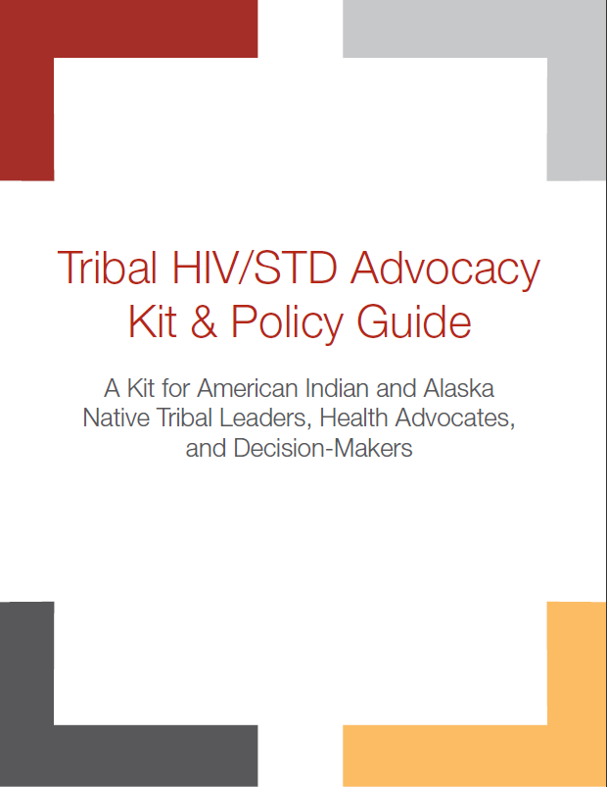
Kit contains:
Advocacy Guide
Flash Drive with:
  Policy Templates
  References & Additional information
  Media campaign materials
Notes:
The Advocacy Kit includes:
Facts and ﬁgures on the importance of promoting sexual health in our communities
Tools for assessing community readiness to implement a sexual health program
Information on the policy change process and sample policy and resolution templates
Case studies of effective models for change in Tribal communities, and
Additional resources to strengthen community sexual health activities and policies

Slide 4
Health
Physical, Emotional, Social, & Spiritual
Reproductive Health
Intimate Relationships
Assault / Violence
STDs
HIV/AIDS
Planned pregnancy
Sexual Health
Notes:
Sexual expression is a normal part of human development – it is a gift from the creator that brings both pleasure and responsibility. While this topic might be uncomfortable to discuss, it is essential that Tribal health advocates and decision-makers step up to the challenge, and support both teens and adults in talking about these issues and making healthy sexual decisions.

Slide 5
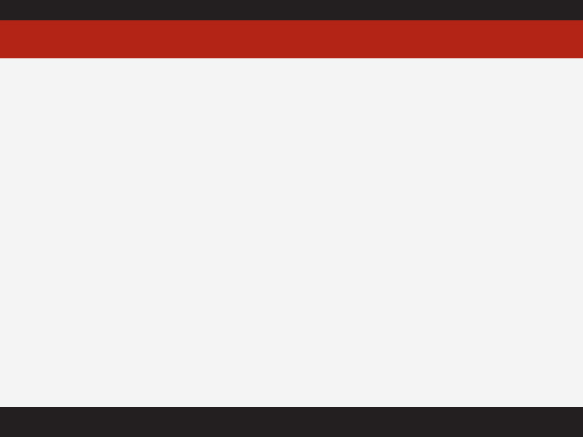

Rationale
Social Impacts
1 in 5 AI/AN girls give birth before turning 20
15-24 year olds make up almost 50% of all new STD cases
STD infections can increase possible HIV transmission by 2-5 times
AI/AN women are over 2.5 times more likely to be raped or sexually assaulted than other women in the U.S.
Learning one’s STD/HIV status early helps prevent spread to others and allows a person living with HIV to seek life-extending care.
Economic Impacts
1 HIV+ treatment = $2,100/month
1 case of Chlamydia = $20 for men and $244 for women
1 case of Gonorrhea = $53 for men and $266 for women
1 case of Syphilis = $444
1 case of HPV = $27 for men and $1,228 for women
1 case of Genital Herpes = $511 for men and $417 for women
2
3
Notes:
Looking at pages 2-4 of the guide…
Do any of these figures surprise you?
As decision-makers, what information here most concerns you?
Given the limited budgets that many IHS, Tribal, and Urban Indian (I/T/U) clinics experience, poor sexual health outcomes can pose a sizable economic burden if not adequately prevented.

Slide 6
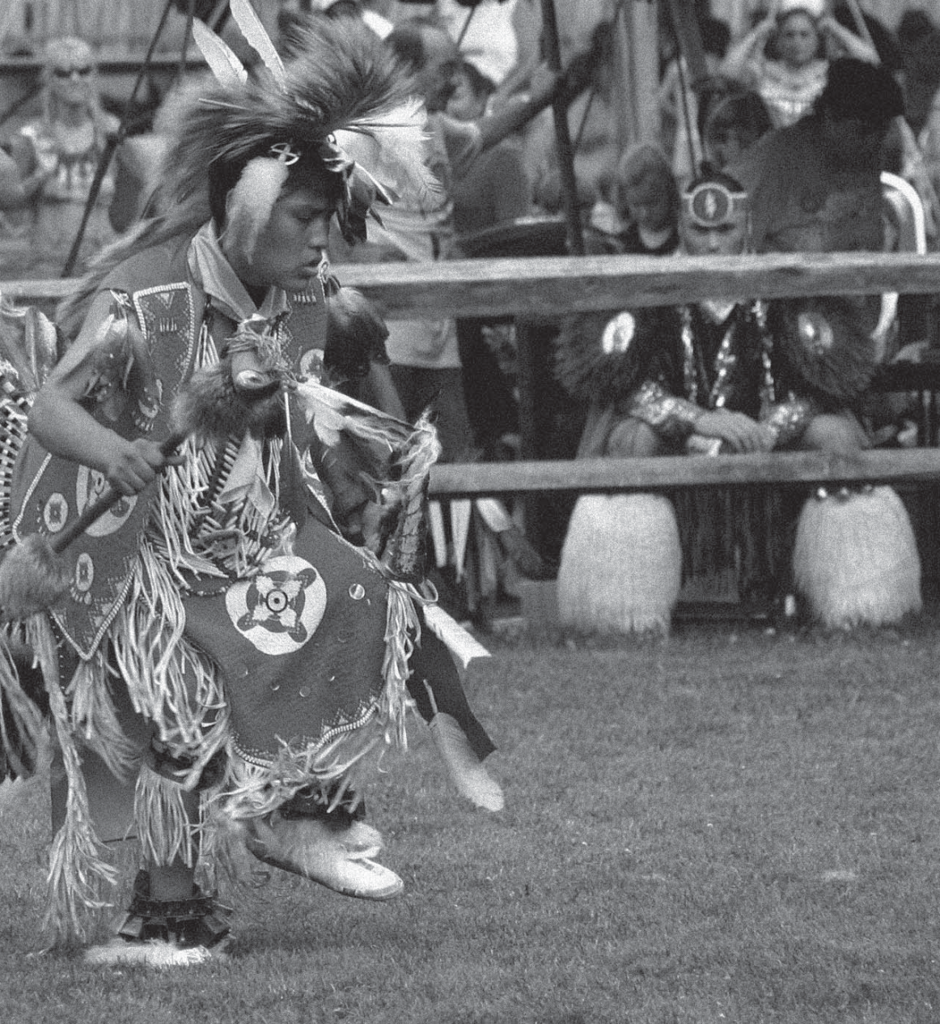
“These statistics demonstrate the need for ongoing initiatives that help make HIV testing, education,
and health care a routine part of our health services.”
Dr. Yvette Roubideaux, M.D., M.P.H.
Director, Indian Health Service
Notes:
The Indian Health Service strongly supports the use of this Advocacy Kit.
“These statistics demonstrate the need for ongoing initiatives that help make HIV testing, education,
and health care a routine part of our health services.”
– Dr. Yvette Roubideaux, M.D., M.P.H.
Director, Indian Health Service

Slide 7
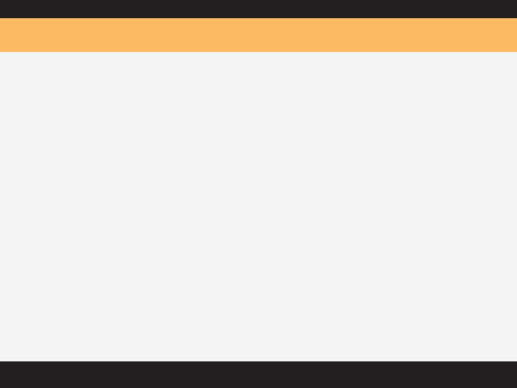
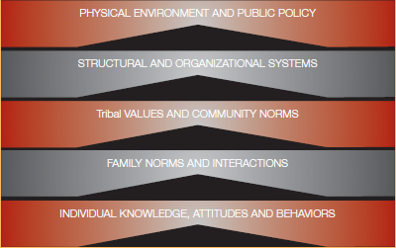
Prevention & Planning
Select activities that can address each of these domains…
Build on your community’s resources & assets
Select the right activities & interventions for your community
5
Notes:
To comprehensively promote health and wellbeing, our STD/HIV activities should address each of these domains that influence health behavior:
The physical environment
Organizational systems
Tribal values and community norms
Family values and interactions
Individual knowledge, attitudes, and behaviors
Looking at page 3 of the “Information and Resources” handout (which contains a Complete List of Activities and Interventions)…
Which of these strategies might be lacking in your community?
Which look most interesting/promising to you?
As a decision-maker, which of these strategies are within your jurisdiction?
Physical Environment & Public Policy
• School policies regarding comprehensive sex education or STD screening in school
• Clinic policies regarding routine HIV testing
• Clinic policies regarding annual STD testing for youth
• Community policies regarding teen access to condoms
• Community policies addressing drug and alcohol use or gang activity, which can increase sexual violence and encourage unhealthy decision-making
Structural & Organizational Systems
• The formation of workgroups or committees to address sexual health challenges
• Communication and referral systems between schools, health programs, and clinicians
• Youth’s perception of the clinic as being “confidential” and “teen friendly”
• Referral systems to get HIV positive patients to appropriate treatment and care
• Referral systems to get sexual assault victims to appropriate treatment and care
• Clinic practices regarding the reporting of STD/HIV cases to the state health department
• Clinic practices regarding the use of Expedited Partner Therapy (EPT)
Community Norms & Interactions
• Restoration of traditional coming-of-age ceremonies
• Community norms about talking to teens about sexual health and intimate relationships
• Community norms about using condoms and birth control
• The fear, stigma, and discrimination that often surrounds HIV, STDs, and sexual assault
Family Norms & Interactions
• Family communication about values, sexual health, and intimate relationships
• Family communication about condoms and birth control
Individual Knowledge, Attitudes, and Behaviors
• Access to comprehensive sex education in school
• Private and confidential access to condoms and birth control
• Peer-to-peer education programs that include sexual health topics

Slide 8
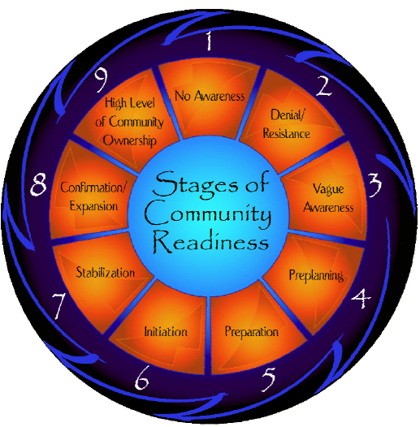
Community Readiness
“Is your community ready for an STD/HIV program or policy?”
A Community Readiness survey looks at:
  Your community’s perception of the “problem”
  How important they feel the “problem” is
  What actions they feel would be appropriate to address the “problem”
  How committed they are to preventing the “problem.”
6
Notes:
Our STD/HIV prevention program activities should also align to the readiness level of our community.
The Community Readiness model identifies six critical dimensions that can influence a community’s ability to take action to prevent HIV/STDs, including:
Existing community efforts and activities
Community knowledge and awareness about current efforts and activities
The extent to which tribal leadership supports community efforts and activities
The social climate and community attitudes toward HIV/STD
Community knowledge about HIV/STDs
Resources dedicated to HIV/STDs prevention, screening, and treatment (like trained staff, funding, and space).
As conceived by the Community Readiness Model, tribes can display varying levels of readiness within each of the six domains, ranging on a nine-point scale from “no awareness” to a “high level of community ownership.”
Where do you think our community would rank on this scale?

Slide 9
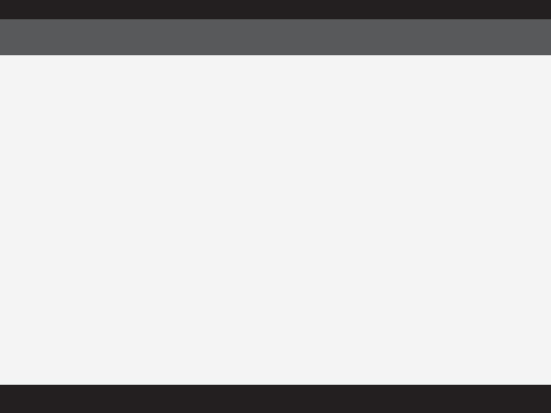
Policy Change
Policy change is an important tool for promoting sexual health and wellbeing
Formal Policies
  Tribal resolutions or ordinances
  School policies
  Clinic policies
Informal Policies
  May be first step toward formal policies
  Unwritten agreements or behavioral expectations
9
12
Notes:
Policies can improve clinical services, strengthen educational programs, change social attitudes and norms, help community members know what is expected of them, and can demonstrate a Tribes commitment to certain issues or actions. Policy change can help sustain HIV/STD services or activities despite personnel turnover or leadership change.
Informal policies may be useful for hosting one-time screening events, promoting public awareness campaigns, or for making condoms available in community settings. Informal policies can set the stage for healthy social norms.

Slide 10
Policy Change
STEP 1: Create a Committee and Involve Stakeholders
STEP 2: Develop an Action Plan
STEP 3: Gather Background Information
STEP 4: Analyze Available Data
STEP 5: Review Sample Policies and Resolutions
STEP 6: Demonstrate Need and Build Community Support
STEP 7: Draft a Policy
STEP 8: Obtain Feedback
STEP 9: Revise as Necessary
STEP 10: Pass the Policy
STEP 11: Implement the Policy
STEP 12: Evaluate the Policy
10
Notes:
There are a number of steps involved with writing, passing and enforcing policies to protect the health of your community. The following is a general overview of the path you might travel when embarking on this journey. Different policies require different approaches; no two policy change processes will be exactly the same.
(If appropriate for your audience, you might want to summarize each step in a sentence…)
Create a committee and Involve stakeholders: Successful policy change and enforcement requires the support and approval of your entire community (elders, youth, school admin, etc.). By obtaining input from all perspectives, no group will feel alienated by the process, and you will better understand the concerns that need to be addressed before widespread community support is achieved.
Develop an Action Plan: An action plan will help to ensure that your policy is developed, passed, and implemented in an efficient and effective manner. The plan should include input from stakeholders participating in the planning process.
Gather background Information: Tribal history with sexual health teachings and any prior or current school- or clinic-based sexual health policies.
Analyze Available Data: You need to compile appropriate data including data from your health clinic, Tribal programs, State & County HIV/STD programs, etc. This will help you make an educated decision about the type of policy you ought to pursue. If more information or data is needed you could conduct a survey or focus group. Then decide on a few policies to look into further.
Review Sample Policies and Resolutions
Demonstrate Need and Build Community Support: gather information about your community’s current level of support for your policy, and coordinate activities to educate and build support among community members and decision-makers. Once a type of policy has been chosen, it is crucial that you initiate a plan to build community awareness about the problem you’ve identiﬁed and support for the solution you’ve designed.
Draft a Policy: Be sure to not leave any important information out, using an existing checklist will help (available in the Kit).
Obtain Feedback: distribute it to key individuals for their review (tribe’s general manager, tribal health director, community health representatives, a tribal lawyer, etc.).
Revise as Necessary: Consider all input received and make any needed changes. Discuss revisions and policy, decide if it is still the right policy for the community, since you now have their feedback, if so it should now be ready to go through the Tribe’s approval process.
Pass the Policy: May need to make a presentation about the policy to Tribal Council and/or the School Board, etc. Be prepared to defend the policy and anticipate questions so your answers are ready.
Implement the Policy: Plan to announce the policy before it will take effect. Advertise with posters, pamphlets, in Tribal Newsletters, at meetings, and have copies available for community members.
Evaluate the policy: Is the policy successful after 6 months, 12 months, 2 years? Determine which outcomes would be most valuable and feasible to assess, possibilities include:
Percentage of staff who have been trained to provide counseling and testing
Percentage of charts that document screening took place – requires that chart audits be done on a routine basis to check documentation
Number of patients provided age- and gender-appropriate HIV/STD screening per month
Percentage of STD/HIV cases reported per month
Number of referrals provided per month
Number of prevention brochures distributed to patients per month

Slide 11
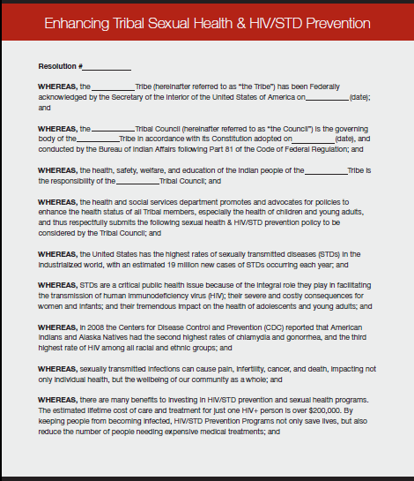
Policy Change
Enhancing Tribal Sexual Health & HIV/STD Prevention
Implementing State HIV/STD Reporting Guidelines
Implementing Universal HIV Testing
Implementing Recommended STD Screening Guidelines
Implementing Expedited Partner Therapy
Notes:
(Templates for each of these policies are included on the flash drive for easy editing and use.)
Which sexual health policies are you most interested in?
As a decision-maker, which of these policy decisions are within your jurisdiction?

Slide 12
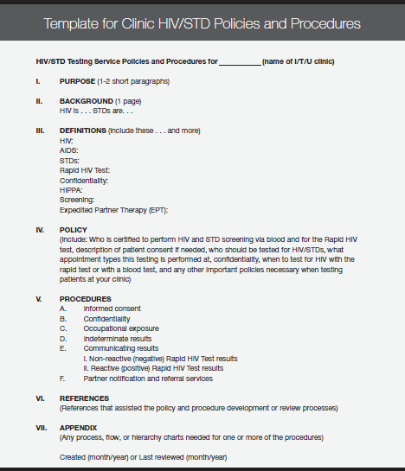
Policy Change
Template for Clinic HIV/STD Policies and Procedures
Clinic-Based Policies and Standing Orders For HIV/STD Screening and Epidemiologic Treatment
Notes:
(Templates for each of these policies are included on the flash drive for easy editing and use.)
Which sexual health policies are you most interested in?
As a decision-maker, which of these policy decisions are within your jurisdiction?

Slide 13
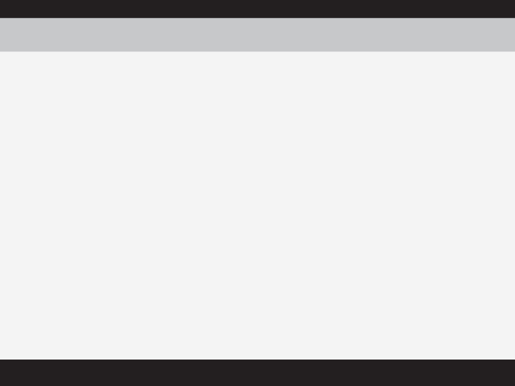
Testing & Vaccination
HIV Testing Recommendations
STD Testing Recommendations
CDC recommends HIV screening for everyone 13–64 years old
If high-risk, a person should be tested at least once a year
If no known risk, a person should be tested every 3–5 yrs
All pregnant women should be tested for HIV during pregnancy
www.cdc.gov/STD/treatment
17
HPV Vaccination Recommendations
CDC recommends the vaccine for women 13–26 years old
Men 9–26 years old can also receive it
It’s free, regardless of insurance for AI/AN females under 19
Prevents strains of HPV that can lead to cervical cancer and genital warts
14
18
Notes:
HIV Testing Recommendations:
The CDC recommends HIV screening for everyone 13 to 64 years-old as part of a regular healthcare visit. Routine HIV testing can held reduce stigma and normalize testing, help people learn their HIV status, link patients to early treatment and care, and can help reduce HIV transmission to uninfected partners.
IHS supports these recommendations
STD Testing Recommendations:
The CDC updates STD testing guidelines regularly, so it is best to consult their website for the most up-to-date information: www.cdc.gov/STD/treatment
HPV Vaccination Recommendations:
IHS supports these recommendations
1 of the 2 available vaccines has been shown to be effective in men protecting against genital warts, Gardasil.

Slide 14
Treatment
HIV Treatment
STD Treatment
A wide variety of treatment options that can help people living with HIV experience long and productive lives
Resources:
  AIDS Info phoneline
  National HIV/AIDS telephone consultation service
  National perinatal HIV consultation and referral service
Most STDs can be treated, and many can be cured with an antibiotic
Expedited Partner Therapy
Resources:
  http://www.cdc.gov/STD/ treatment/
  State by state EPT laws: www.cdc.gov/STD/EPT/legal/default.htm
19
20
Notes:
Expedited Partner Therapy (EPT) is the clinical practice of treating the sex partners of patients diagnosed with chlamydia (CT) or gonorrhea (GC), by providing prescriptions or medications to the patient to take to his/her partner without the health care provider ﬁrst examining the partner. EPT is currently recommended for heterosexual partners; current research does not offer guidance for EPT for men who have sex with men

Slide 15

Tribal Models & Best Practices
Tribal models and best practices can be used as an example of what worked well for others.
  Case Study 1
  Case Study 2
21
Notes:
Case Study 1: Revising an Existing HIV Policy Manual
The revision committee for this Tribe found that the most notable challenges experienced included finding funds to support the process, and identifying one person to spearhead the revision process. It took time to find someone with enough time to organize and schedule the workgroup and contact appropriate stakeholders.
A tip from the Workgroup: When revising or creating policies, always include Tribal Leadership to ensure their acceptance and approval of the policies.
Changes to the tribe’s HIV policy manual included:
Better defining patient confidentiality
Creating consequences for breaches of confidentiality
Adding culturally-appropriate services
Adding culturally-appropriate language
The revised policies were based on the State’s, IHS’s, and CDC’s recommendations for HIV/STD testing as a standard of care, and the reporting of notifiable conditions.
Case Study 2: Developing a New HIV/STD Policy Manual
This was the first formal HIV/STD policy manual for the Tribal Clinic.
Tip: Once providers were on board the process became very easy, and each new protocol that is created is approved quicker each time.
Important components of the tribe’s STD/HIV policy manual:
Standard opt-out HIV/STD testing for all patients aged 13-64 years. Every patient is asked if they want to be tested and has a chance to decline. Exceptions include, but are not limited to, the Emergency Department and prior to in-patient treatment (testing usually occurs but not always).
A definition of patient confidentiality
Suggested verbiage for communicating results to patients
Information on reporting notifiable conditions, which were based on guidelines set by the State.
Recommendations for partner notification, which were based on guidelines set by the State and CDC.
Processes for providing follow-up care for positive patients, which were based on recommendations set by the CDC.
Protocols for reducing maternal-to-child transmission, including protocols for labor and delivery and the emergency department, when a pregnant woman in labor presents and has had little or no prenatal care (i.e. use Rapid HIV Test to test for the mother’s HIV status and if positive, give a round of HRT medication to the mother to decrease the chance of transmission to the baby during birth).

Slide 16
Steps You Can Take to Promote Sexual Health and Wellbeing
Start a dialogue about these issues with your family and friends. For helpful tips on talking about sex with your children, grandchildren, nieces, or nephews, visit: www.noplacelikehome.org/nativeamerican.php
Increase community awareness about sexual health topics by hosting public forums and by participating in community observances and outreach events.
Support a resolution documenting your Tribes’ commitment to sexual health.
Work with local schools to strengthen your school’s sex education curricula. And offer students confidential STD screening at school.

Slide 17
Steps You Can Take to Promote Sexual Health and Wellbeing
Work with your Tribe’s clinic to update its HIV/STD screening and treatment policies and practices.
Form a workgroup to create a local action plan to address HIV/STD, unintended teen pregnancy, and/or sexual violence in your community.
Help reduce stigma surrounding these issues by reaching out to those who are affected.
Learn how to protect yourself against HIV and STDs.
Get tested - and encourage others to do the same. Simple blood, urine, and saliva tests are available for different STDs/HIV. Most infections can be treated or cured!

Slide 18
Questions?
Ideas?
Discussion?
As decision-makers, what can you do to promote sexual/reproductive health in your community?

Slide 19
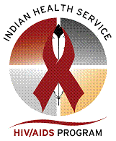
Additional Resources
IHS HIV/AIDS Program: http://www.ihs.gov/hivaids/
IHS STD Program:
http://www.ihs.gov/epi/index.cfm?module=epi_std_main
AIDS Education & Training Centers (AETC): http://www.aids-ed.org/
National Network of STD/HIV Prevention Training Centers (NNPTC):
http://depts.washington.edu/nnptc/
Native CBA Providers:
http://www.ihs.gov/hivaids/index.cfm?module=links_cba
National Native American AIDS Prevention Center: http://www.nnaapc.org/
CASAE: Advancing HIV/AIDS Prevention in Native Communities: www.happ.colostate.edu
Project Red Talon, Northwest Portland Area Indian Health Board:
http://www.npaihb.org/epicenter/project/project_red_talon/
Alaska Native Tribal Health Consortium’s Youth Website: https://www.iknowmine.org/
National Chlamydia Coalition (NCC): http://www.prevent.org/NCC
*References for the statistics in this presentation are located
on the USB/flash drive that accompanied your Kit.

Slide 20
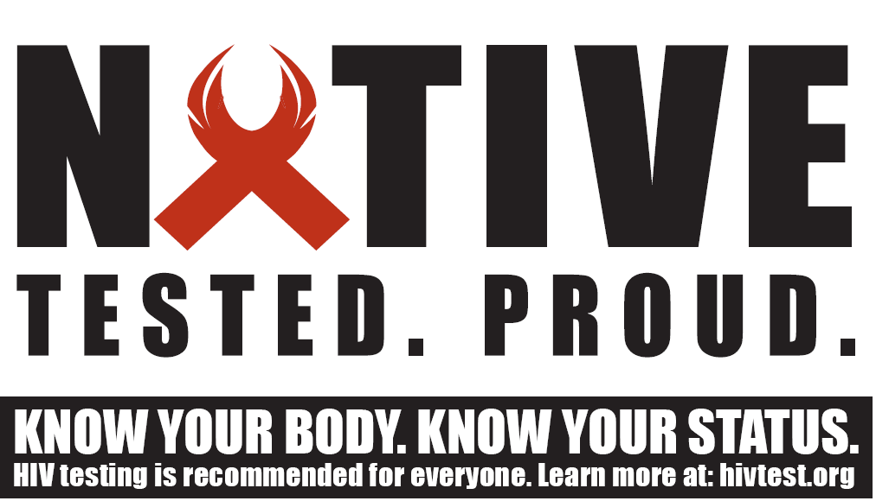

Slide 21
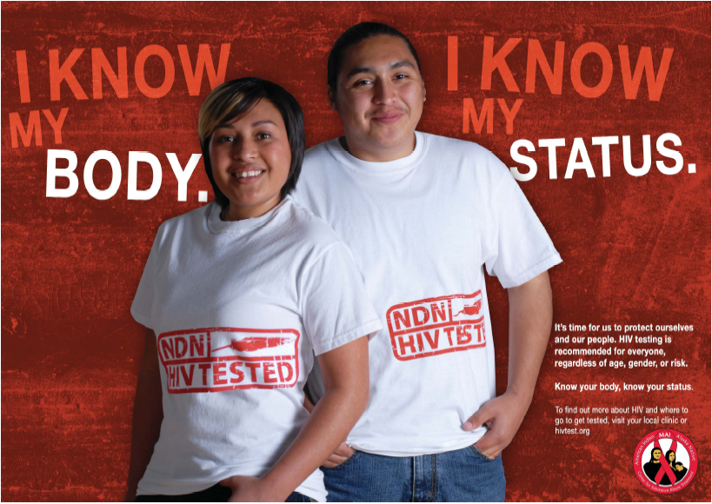

Slide 22
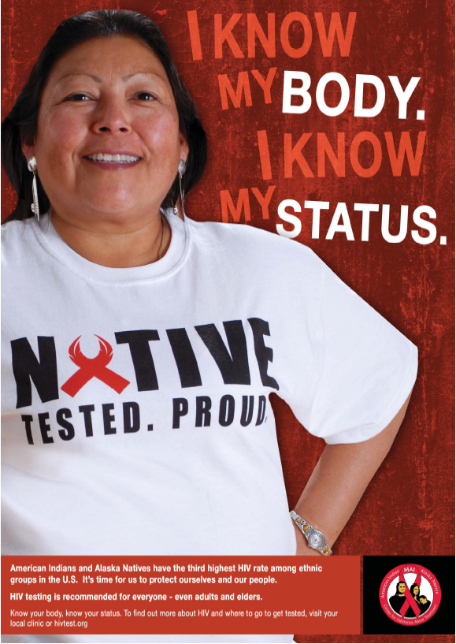

Slide 23
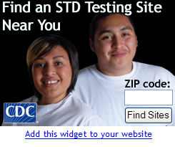
www.npaihb.org/epicenter/project/project_red_talon/

Slide 24
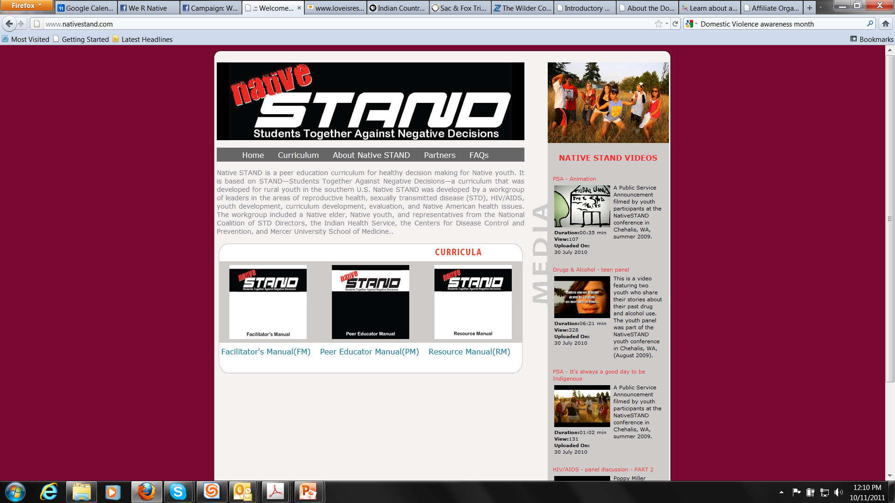


Slide 25
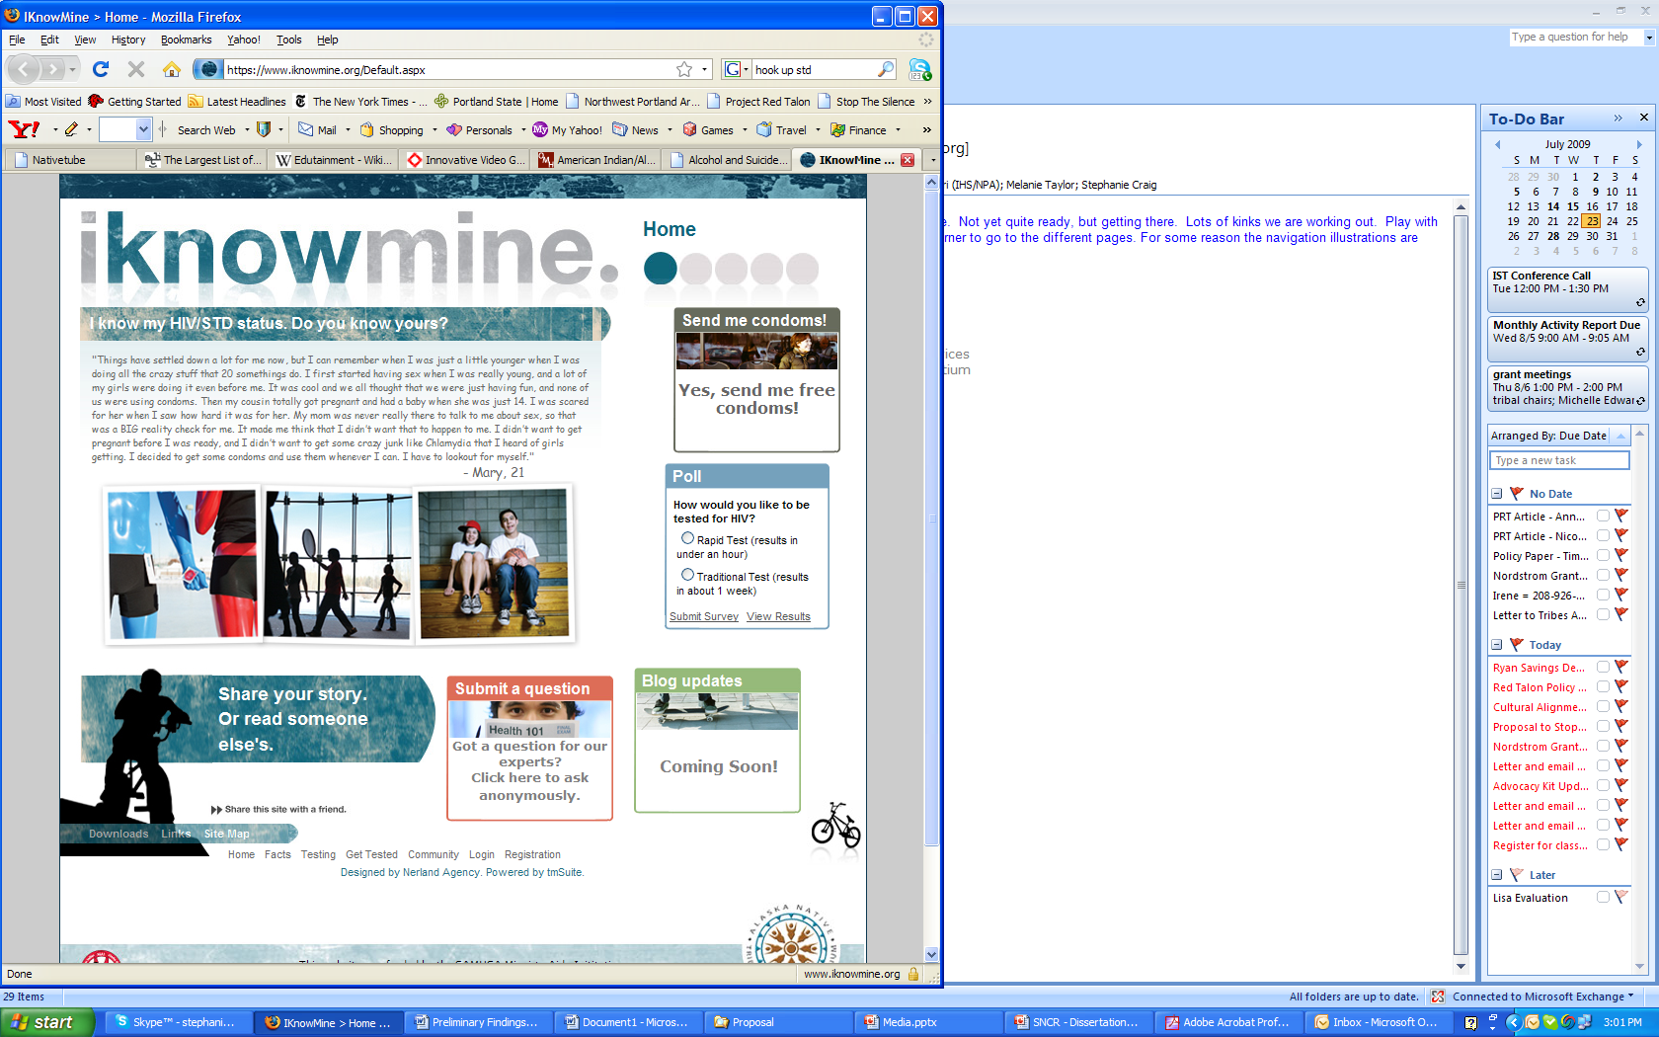

Slide 26
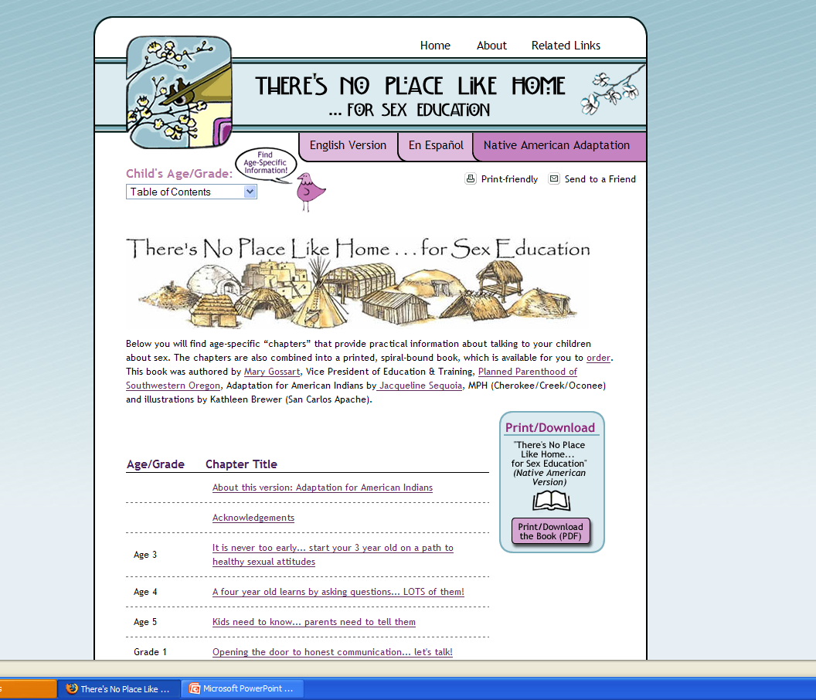
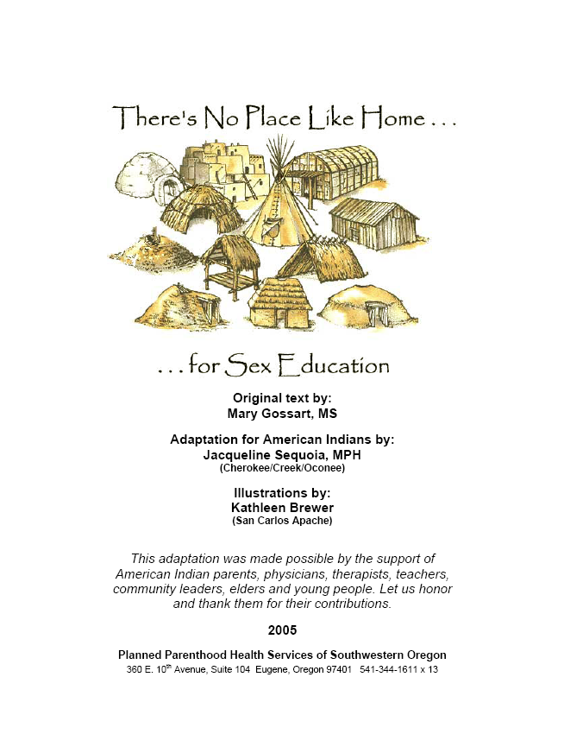
www.no placelike home.org/ native american

Slide 27
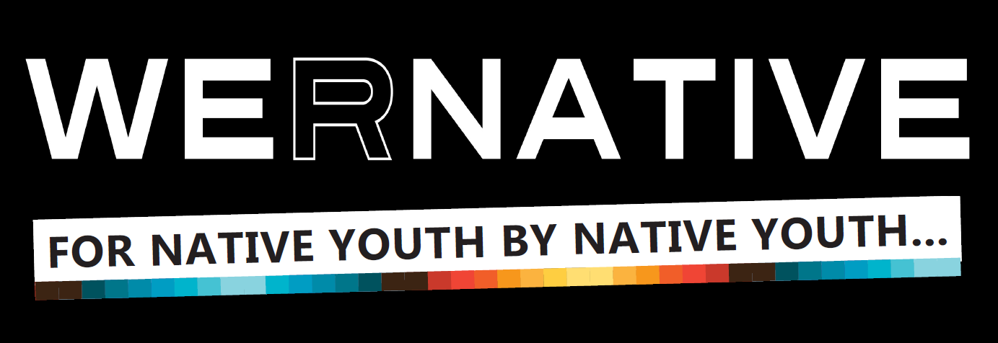

Slide 28
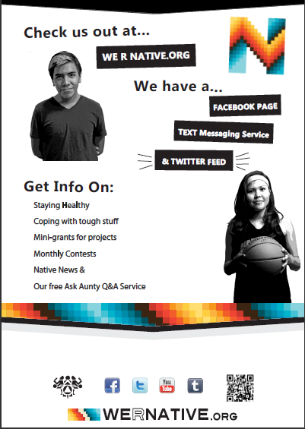
Notes:
Website: theory-based, offering culturally-appropriate health information, with tools for behavior change & positive youth development.
The ultimate goal is to use Facebook, text messaging and other social media to redirect users back to our website for more information. We decided to launch the Facebook and text messaging components before launching the website – to start building brand loyalty.

Slide 29
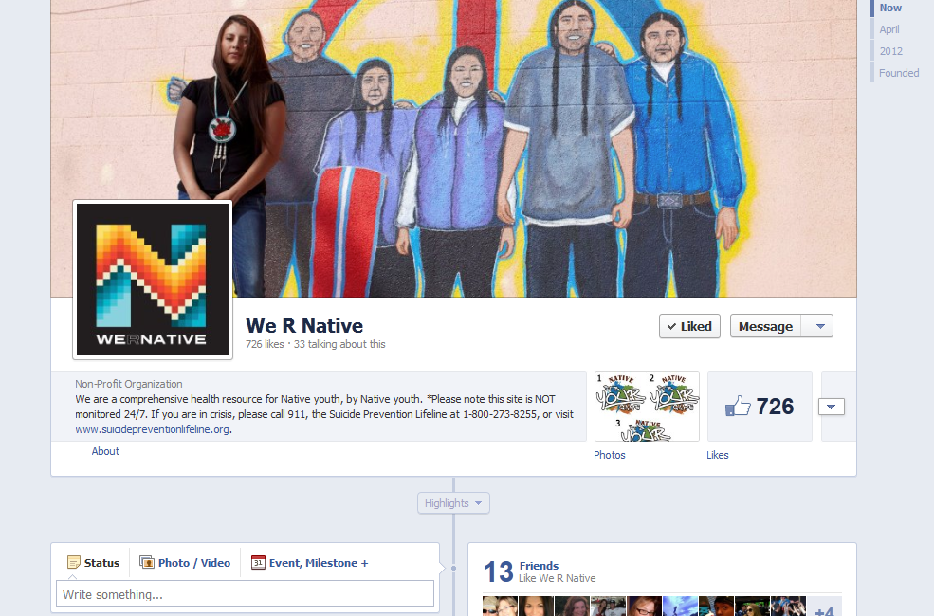
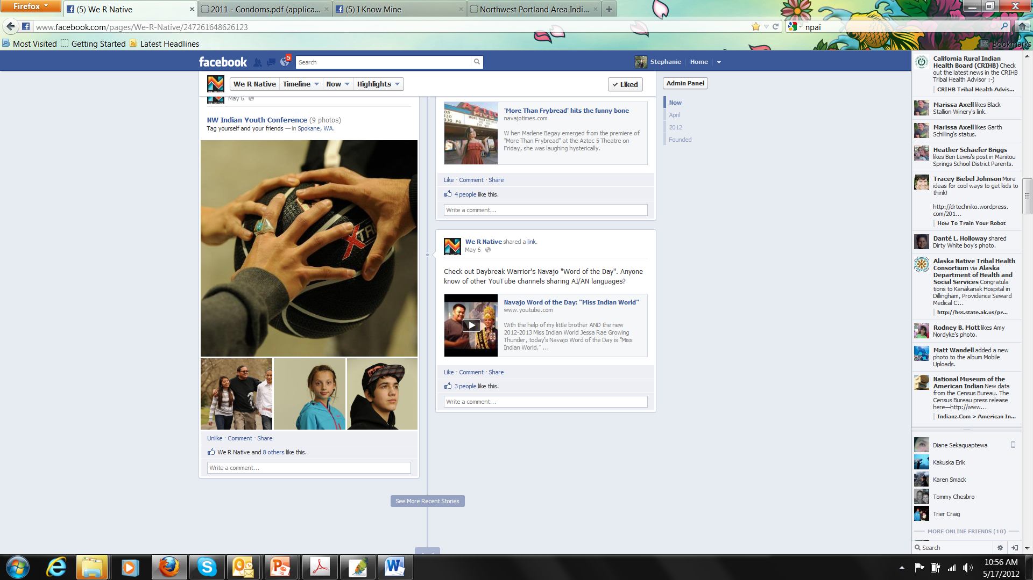
Notes:
We R Native Facebook

Slide 30
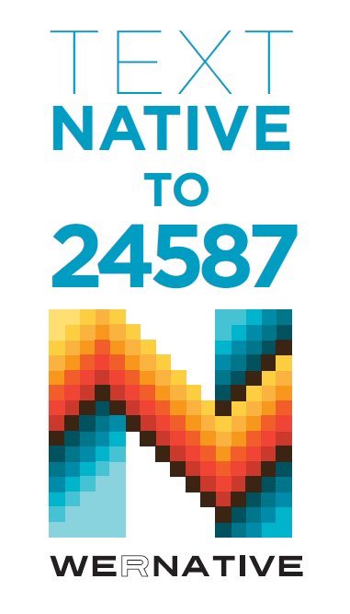
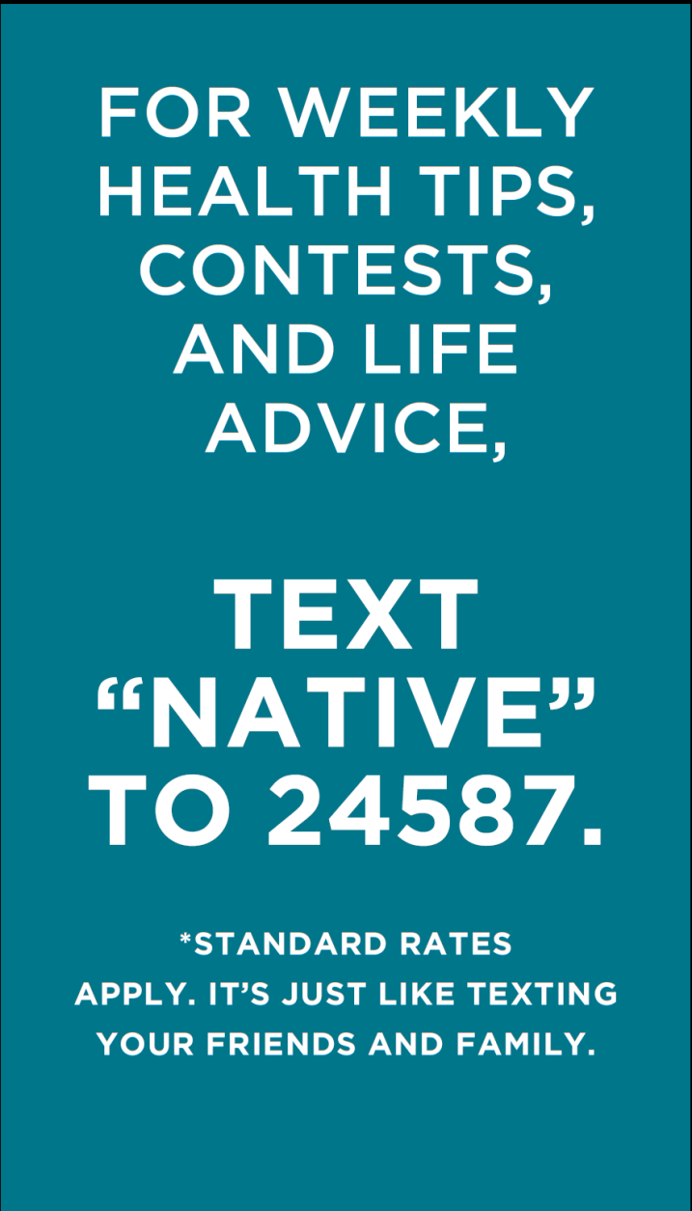
Notes:
The text messaging service is designed to support the website… Currently have over 850 active contacts.
To join the text messaging service, text NATIVE to 24587 (standard text messaging rates apply).
Weekly messages include teachings from Native leaders, tips for wellness and life balance, updates on health observances, ideas for taking action in your local community, and links to more information.

